Slide 1
Live with Gateway API v1.2

Slide 2
Live with Gateway API v1.1.1 🤦‍♂️

Slide 3


Flynn
Tech Evangelist
Buoyant
Mike Morris
Senior Product Manager
Microsoft

Slide 4
Who is this for?
Platform engineers building infrastructure for multiple application teams.
Application developers who want resiliency and safety with blue/green or canary deploys and related functionality.
Anyone interested in growing their skills by learning a single API which can be used to configure dozens of different products.

Slide 5
What’s on the agenda?
Brief description of the ingress problem and how Gateway API relates to it.
Brief description of service meshes and why Gateway API is relevant there too.
Workshop! Get your hands dirty and try all this out.

Slide 6
What do you need for this workshop?
A Kubernetes cluster. We’ll be using k3d, but the type of cluster doesn’t much matter.
To follow along, you’ll need kubectl, helm, bat, and optionally yq. We’ll download and install either linkerd or istioctl during the tutorial.
Check out the workshop source https://github.com/BuoyantIO/gateway-api-workshop/

Slide 7
What do you need for this workshop?
Clone the workshop repo and MAKE SURE YOU’RE USING AN EMPTY CLUSTER.
To use a k3d cluster, run bash create-cluster.sh
Any kind of cluster should do, really.
(Want to use a Civo cluster? https://www.civo.com/ seminar-signup 🙂)

Slide 8
The Ingress Problem

Slide 9


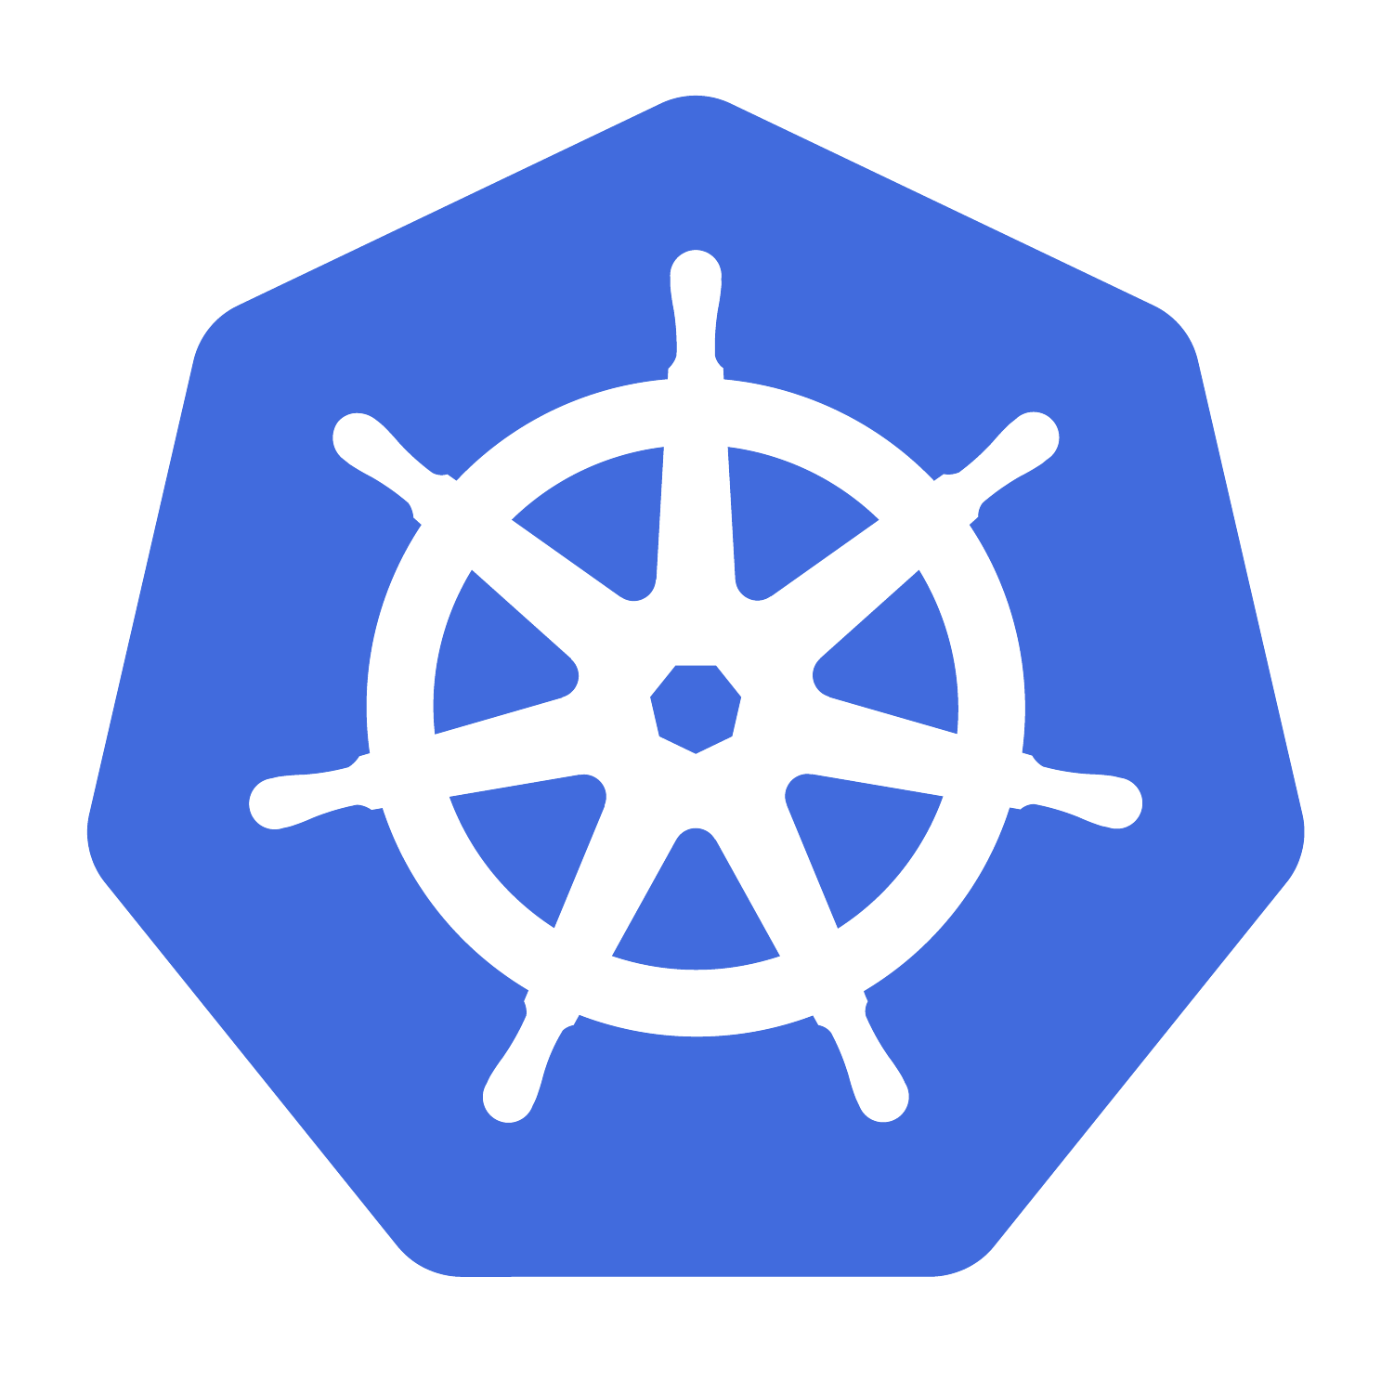
How do you let people use your services?
🧑‍💻
Notes:
The ingress problem is always the first problem cloud-native devs run into -- and it’s often the only problem they run into.

Slide 10
The Wild West of Ingress v1

Slide 11
Back in the old days…
We had the Ingress resource - it’s been widely used, but has some serious problems.
Monolithic - one resource to configure all of your routing rules requires high trust between teams and can be fragile to misconfiguration.
Too limited - the scope of the Ingress resource itself was quite small, so even basic functionality required extensions for each implementation.
Poor extensibility mechanisms - with no standardized patterns for adding capabilities, bespoke unstructured annotations and supplemental custom CRDs proliferated.

Slide 12
Introducing Gateway API

Slide 13
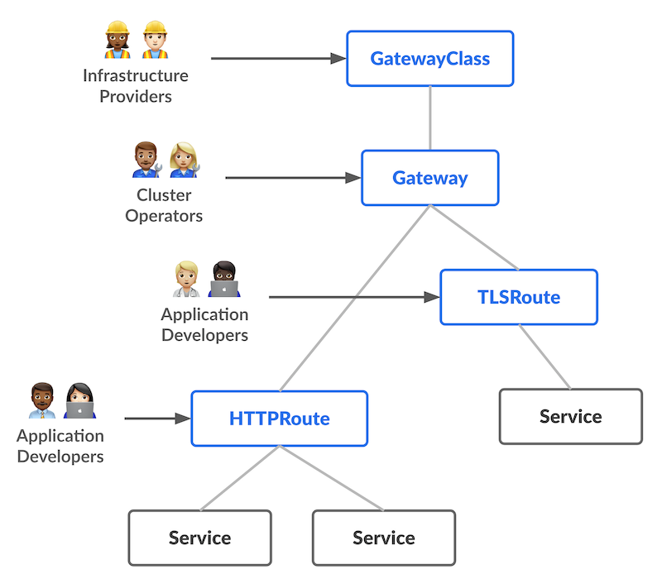
Gateway API for ingress traffic management
Gateway API is a project within Kubernetes SIG-Network
Started in 2020 as “Ingress v2” primarily focused on tackling the “annotations wild west” of the Ingress resource
Reached GA with a v1.0 release in October 2023
…but we’re not done yet and still actively adding more capabilities!

Slide 14
Gateway API for ingress traffic management
Role-oriented design for config delegation
Standard generic API for common functionality
…but extensible for implementation-specific needs!

Slide 15
Should I start using Gateway API now?
New ingress or service mesh deployment? Consider starting with Gateway API.
Existing stable deployment? Learn concepts, plan for the future.
“Most collaborative API in Kubernetes history”, come help us build it!

Slide 16

Traffic management BEFORE
apiVersion: networking.k8s.io/v1
kind: Ingress
apiVersion: networking.istio.io/v1beta1
kind: VirtualService
apiVersion: split.smi-spec.io/v1alpha2
kind: TrafficSplit
apiVersion: consul.hashicorp.com/v1alpha1
kind: IngressGateway
apiVersion: getambassador.io/v3alpha1
kind: Listener
apiVersion: projectcontour.io/v1
kind: HTTPProxy

Slide 17

Traffic management with Gateway API
apiVersion: gateway.networking.k8s.io/v1
kind: Gateway
apiVersion: gateway.networking.k8s.io/v1
kind: HTTPRoute

Slide 18
What can we do with Gateway API?

Slide 19
Traffic splitting
Statically configured, coarse-grained routing behavior, based on the service name and percentage of traffic to split.
Examples:
Route 1% of traffic to Foo to Foo-new, and 99% to Foo-orig (progressive delivery)
Route 100% of traffic to Foo to Foo-west or ServiceImport Foo (multi-cluster / failover)

Slide 20
Dynamic request routing
Route traffic based on many attributes of the request:
Headers
Method
HTTP path and query parameters
(...but not body)
Examples:
Progressive delivery anywhere in the call graph
A/B testing anywhere in the call graph
Per-user canaries

Slide 21
HTTP and gRPC
All this stuff works with both HTTP and gRPC
HTTPRoute for HTTP
GRPCRoute for gRPC
Similar resources because similar requests
GRPCRoute went GA in Gateway API v1.1.0
but… use v1.1.1 or higher instead, v1.1.0 has a bug

Slide 22
Demo Architecture

Slide 23
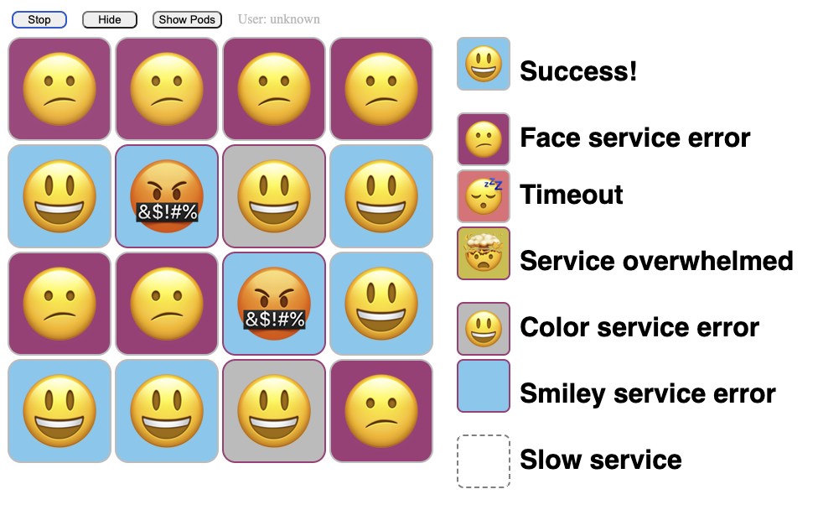
Faces (http://github.com/BuoyantIO/faces-demo)

Slide 24




Faces (http://github.com/BuoyantIO/faces-demo)
😃
😍
Faces GUI
HTTP
smiley
smiley2
face
gRPC
color
color2

Slide 25
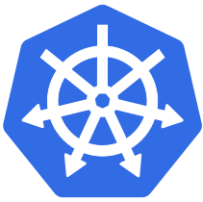
Faces (http://github.com/BuoyantIO/faces-demo)
😃
😍
Faces GUI
HTTP
smiley
smiley2
face
gRPC
color
color2

Slide 26


Faces (http://github.com/BuoyantIO/faces-demo)
😃
😍
Faces GUI
HTTP
smiley
smiley2
face
color
color2
gRPC

Slide 27
Let’s start the workshop!
🤞

Slide 28
Gateway API …for mesh?

Slide 29
Gateway API and GAMMA
The GAMMA initiative is part of Gateway API
Started in 2022 to sort out how to use Gateway API for service mesh implementations.
Various service meshes solve a lot of the same problems, even when their implementation choices differ - but we can make things better for users by adopting common APIs.
Linkerd started using Gateway API for mesh traffic routing in 2.13
Istio started using Gateway API for ingress in v1.9 and for mesh traffic routing in v1.19

Slide 30
Gateway API and GAMMA
Mesh traffic routing is configured with the Gateway API HTTPRoute and GRPCRoute resources
use parentRef to associate the HTTPRoute with the Service you want to affect
use backendRefs to describe where you want the traffic to go

Slide 31
Gateway API and GAMMA
Many things you can’t currently do, but we are actively working on making all of this better. Quickly.
GEP-1731 introduced HTTPRoute retries, which landed in the experimental channel in Gateway API v1.2 - start looking for downstream implementations soon!
Work in progress to bring timeouts and retries to GRPCRoute too.
Rate limiting policy is a bit trickier, but it’s on our radar and some implementations have started experimenting already.
Identity-based AuthZ policy between services
This is a core mesh capability and we hope to expand our scope to eventually include it!

Slide 32
Traffic splitting: Canary routing
apiVersion: gateway.networking.k8s.io/v1
kind: HTTPRoute
metadata:
name: color-canary
namespace: faces
spec:
parentRefs:
- name: color
kind: Service
group: core
port: 80 # Match port numbers with what’s in the Service resource
rules:
- backendRefs:
- name: color
port: 80
weight: 90 # Adjust the weights to control balancing
- backendRefs:
- name: color2
port: 80
weight: 10

Slide 33
Dynamic request routing: A/B testing
apiVersion: gateway.networking.k8s.io/v1
kind: HTTPRoute
metadata:
name: smiley-a-b
namespace: faces
spec:
parentRefs:
- name: smiley
kind: Service
group: core
port: 80
rules:
- matches:
- headers:
- name: "x-faces-user" # X-Faces-User: testuser gets the B side of the test
value: "testuser"
backendRefs:
- name: smiley2
port: 80
- backendRefs:
- name: smiley
port: 80

Slide 34
Faces (http://github.com/BuoyantIO/faces-demo)
😃
😍
Faces GUI
smiley
smiley2
face
color
color2

Slide 35
…and now back to the workshop!

Slide 36
Gotchas

Slide 37
When things aren’t working
What problems can I run into and where should I look if things go wrong?
The first place to look is generally the status field of your Gateway or HTTPRoute resource.
kubectl get httproute {name} -o yaml | yq .status
This will report many common problems in a standardized way, check the API specification documentation for GatewayConditionType, GatewayConditionReason, RouteConditionType, RouteConditionReason, and similar types for more details.

Slide 38


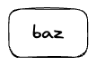
Routing Gotchas
This will not work: you can’t sequence dynamic routing like this.

Slide 39
Routing Gotchas
This will not work: you can’t sequence dynamic routing like this.
Traffic sent directly to bar will indeed be split between bar and baz

Slide 40
Routing Gotchas
This will not work: you can’t sequence dynamic routing like this.
Traffic sent directly to bar will indeed be split between bar and baz
Traffic sent to foo will never get sent to baz
❌

Slide 41


Routing Gotchas
HTTPRoutes distinguish between the “front end” of a Service and the “back ends”
Routing only happens at the Service frontend (a ClusterIP)

Slide 42
Routing Gotchas
HTTPRoutes distinguish between the “front end” of a Service and the “back ends”
Routing only happens at the Service frontend (a ClusterIP)...
…but once a routing decision is made, we go direct to a backend (an endpoint IP)

Slide 43
Routing Gotchas
So rather than setting up this…

Slide 44
Routing Gotchas
So rather than setting up this…
…you’re actually setting up this.

Slide 45
Wrapping up!
We covered how Gateway API can be used for ingress (“North/South”) and mesh (“East/West”) traffic routing tasks.
Consider starting with Gateway API for new ingress or mesh deployments, or just learn and prepare for the future if you’re already running in production.
Look into Flagger or Argo workflows to automate the rollouts we demonstrated!
Come help us build this project! Weekly meetings are posted on the SIG-Network calendar, and can be found on the Gateway API website - input, feedback and contributions from end users is invaluable in helping us design the best solutions!

Slide 46
Q&A

Slide 47
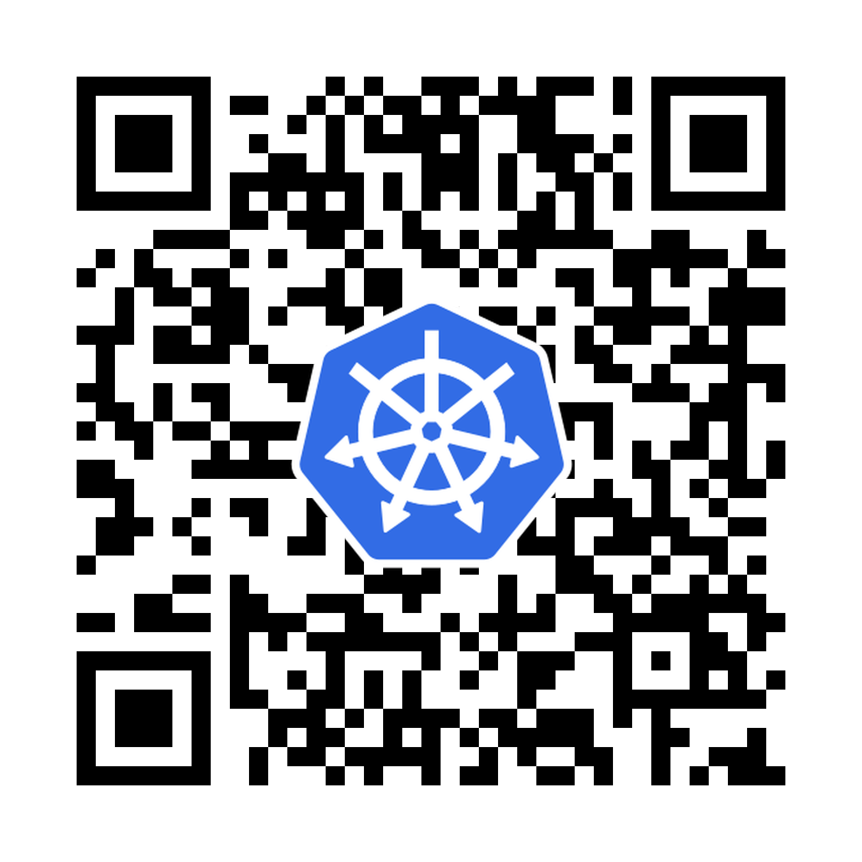
Where to find us!
#sig-network-gateway-api on Kubernetes Slack
github.com/kubernetes-sigs/gateway-api
https://gateway-api.sigs.k8s.io/
Take the Gateway API user survey!

